Slide 1
HDR-Nets 2020 MoGAN: GAN based Next PoA Selection for Proactive Mobility Management
Boyun Jang
boyunj0226@skku.edu
Dept. of Artificial Intelligence
Sungkyunkwan University, Korea
13th October 2020

Slide 2
Overview
Problem Statement
Deep Learning Approaches for Prediction
MoGAN
Evaluations
Conclusions

Slide 3
Problem Statement
Requirement
Sub 10ms mobility delay for 5G
Problem
User assisted reactive mobility management in 4G is potential bottleneck for 5G
Solution
Proactive mobility management
3/21

Slide 4
Problem Statement
Requirements of proactive mobility management
Next Point of Attachment (PoA) prediction with high accuracy
Optimal decision for handover trigger time
Challenges
Dense and Ultra-dense cell deployment in 5G
Real-time prediction and decision algorithms
Solution
This work focuses on prediction of next PoA
A GAN based next PoA prediction mechanism
4/21

Slide 5
DL Approaches for Prediction
Recurrent Neural Network (RNN)
Pros: Available to capture the feature of continuous data
Cons: Gradient vanishing problem occurs with long sequence length $→$ Long-term dependency
Long Short-Term Memory (LSTM)
Pros: Additional cell states enable to save more information of past sequences
Cons: Complex structure results more computational cost
Gated Recurrent Unit (GRU)
Computationally less expensive
Better performance for less complex data
Recurrent Neural Network
Long Short Term Memory
Gated Recurrent Unit
5/21

Slide 6
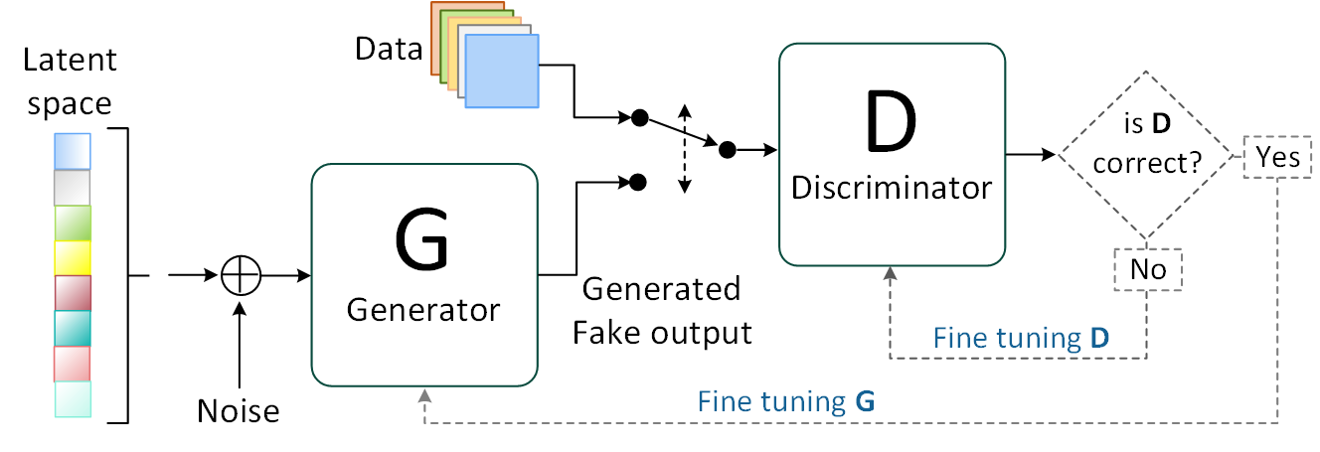
DL Approaches for Prediction
GAN (Generative Adversarial Network)
Various usage
Data generating model
Classification model
Prediction model
6/21

Slide 7
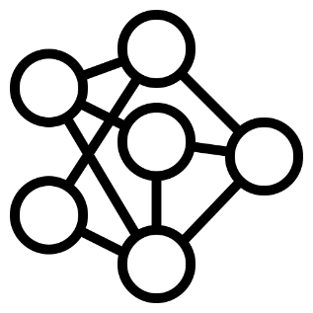
DL Approaches for Prediction
LSTM
GAN
Usually used for prediction
Large amount of data is required for training
Former study achieved 91% of accuracy
Useful feedback from its adversaries
Trained to reflect whole distribution of data
Various types of data are available
7/21

Slide 8
MoGAN
Data preprocessing
Movement history (Sequence of PoA)
Suppose the actual length of sequence is 5
Movement history with less than 5 PoAs: ignored
Movement history with more than 5 PoAs: divided
For each PoA $→$ Transform into One-hot vector
N-dimensional vector if there are total N points in the data
$$\{x_{1}, x_{2}, x_{3}, x_{4}, x_{5}, x_{6}, x_{7}\}$$
$$\{x_{1}, x_{2}, x_{3}, x_{4}, x_{5}\}$$
$$\{x_{2}, x_{3}, x_{4}, x_{5}, x_{6}\}$$
$$\{x_{3}, x_{4}, x_{5}, x_{6}, x_{7}\}$$
8/21

Slide 9
MoGAN
Architecture
Model for predicting next PoA of mobile devices
Learns from the data consisting of previous sequences
Generator
Discriminator
Learns the distribution of previous PoA connections
Generates probable next PoA
Used as prediction model after training completed
Classifies between real PoA sequences and generated ones
Useful feedback for generator
9/21

Slide 10
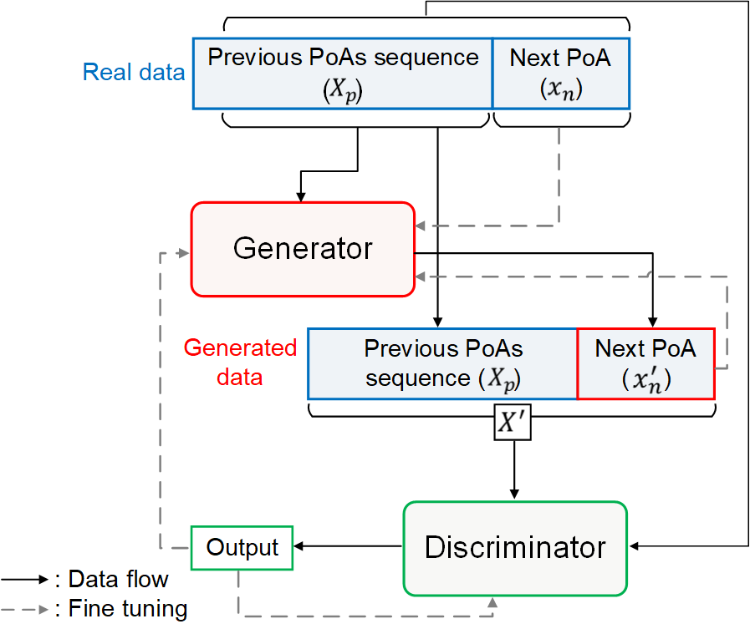
MoGAN
10/21

Slide 11
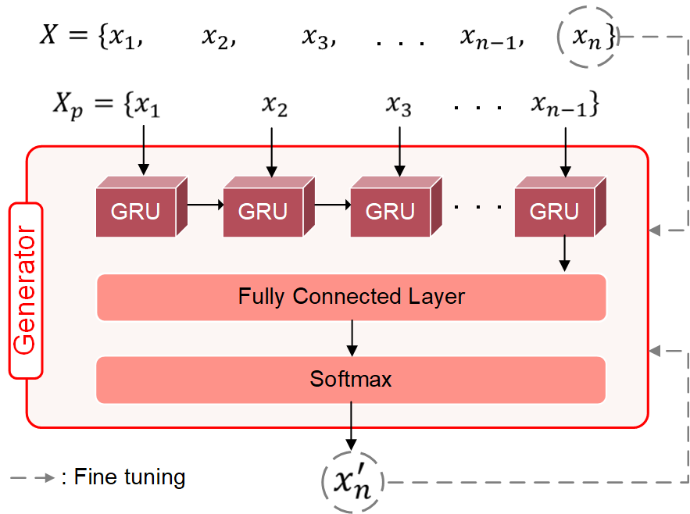
MoGAN
Structure of generator
11/21

Slide 12
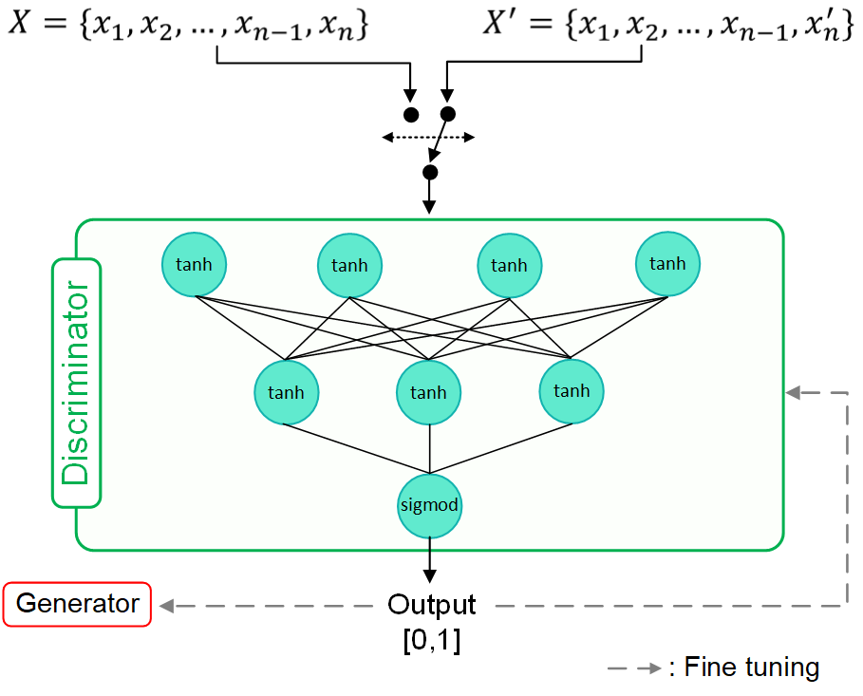
MoGAN
Structure of discriminator
For classification, FC layer performs better than RNN based structures
For recognizing all the properties of structures
12/21

Slide 13
MoGAN
Training procedure of MoGAN
Error function: Binary cross entropy
$y$: Expected value, $y ′$: Predicted value
Step 1 (Minimax step)
$\min_{G_{θ}}{\max_{D_{φ}}{[H(0, D_{φ}\left(X\right))+H(1,D_{φ}(X_{p}+G_{θ}(X_{p})))]}}$
Step 2 (Additional training step for generator)
$\min_{G_{θ}}{[H(x_{n}, G_{θ}(X_{p}))]}$
$$H\left(y, y^{′}\right)=−\frac{1}{N}\sum_{i=1}^{N}{(y_{i}\log\left(y_{i}^{′}\right)+\left(1−y_{i}\right)\log\left(1−y_{i}^{′}\right))}$$
13/21

Slide 14
MoGAN
Algorithm: The training procedure of MoGAN
Initialize: Number of total epoch $n$, number of Step 2 per epoch $α$, randomly initialized weights $θ,φ$ for $G_{θ}, D_{φ}$ Input: $X=\{x_{1}, x_{2}, ⋯, x_{n−1}, x_{n}\}$
1. Error function $←$ binary cross entropy $H$ 2. for $n$ do: 3. $G_{θ}(X_{p})$ predicts next PoA $x_{n}′$ 4. $X^{′} ←$Combine $X_{p}$ with $x_{n}′$ 5. D_loss_real $←$ Get loss value from D for real data $H(0, D_{φ}\left(X\right))$ 6. D_loss_fake $←$ Get loss value from D for generated data $H(1, D_{φ}\left(X^{′}\right))$ 7. Update $φ$ to maximize D_loss_real + D_loss_fake Continue…
14/21

Slide 15
MoGAN
Algorithm: The training procedure of MoGAN
Initialize: Number of total epoch $n$, number of Step 2 per epoch $α$, randomly initialized weights $θ,φ$ for $G_{θ}, D_{φ}$ Input: $X=\{x_{1}, x_{2}, ⋯, x_{n−1}, x_{n}\}$
8. G_loss_Step1 $←$ Get loss value from G for $H(1, D_{φ}\left(X_{p}+G_{θ}(X_{p})\right))$ 9. Update $θ$ to minimize G_loss_Step1 10. for $α$ do: 11. G_loss_Step2 $←$ Get loss value from G for $H(x_{n}, G_{θ}(X_{p}))$ 12. Update $θ$ to minimize G_loss_Step2
15/21

Slide 16
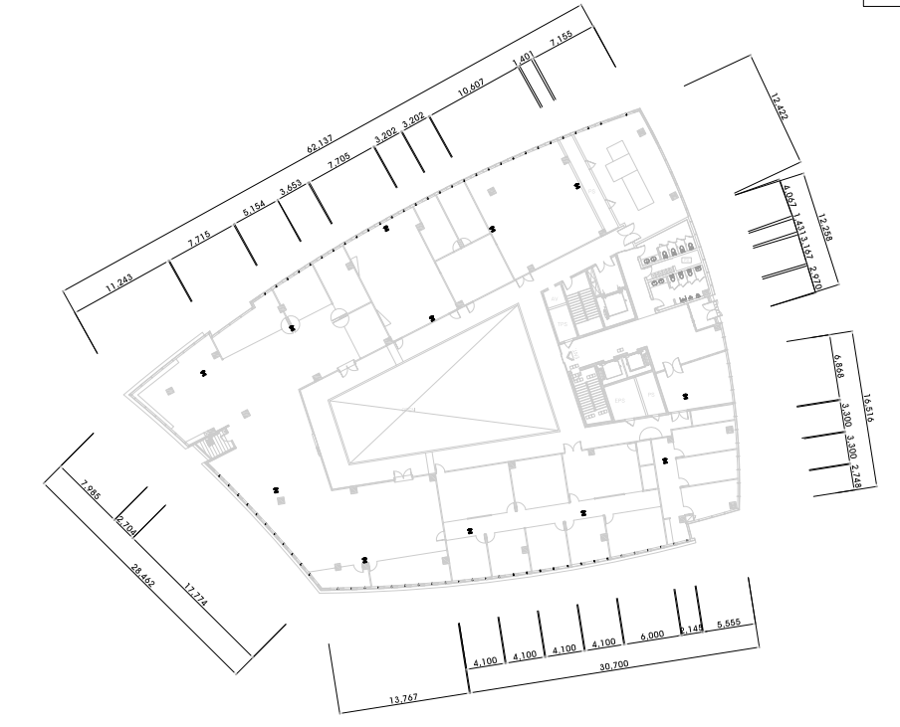
Evaluations
CMD (Campus Mobility Dataset)
Collected from the wireless network of intelligent ICT Convergence Research Center in Pangyo, Republic of Korea
12 APs, 289 users
AP#12
AP#10
AP#11
AP#08
AP#09
AP#07
AP#01
AP#06
AP#02
AP#04
AP#03
AP#05
Configuration
Generator : GRU (512 nodes) + Output layer (12 nodes, softmax)
Discriminator : FC (128 nodes, tanh) + FC (64 nodes, tanh) + Output layer (1 node, sigmoid)
Adam optimizer (lr=0.001), 4000 epochs, 31 sequence lengths, $α=1$
Data $→$ Training : Test = 7 : 3
16/21

Slide 17
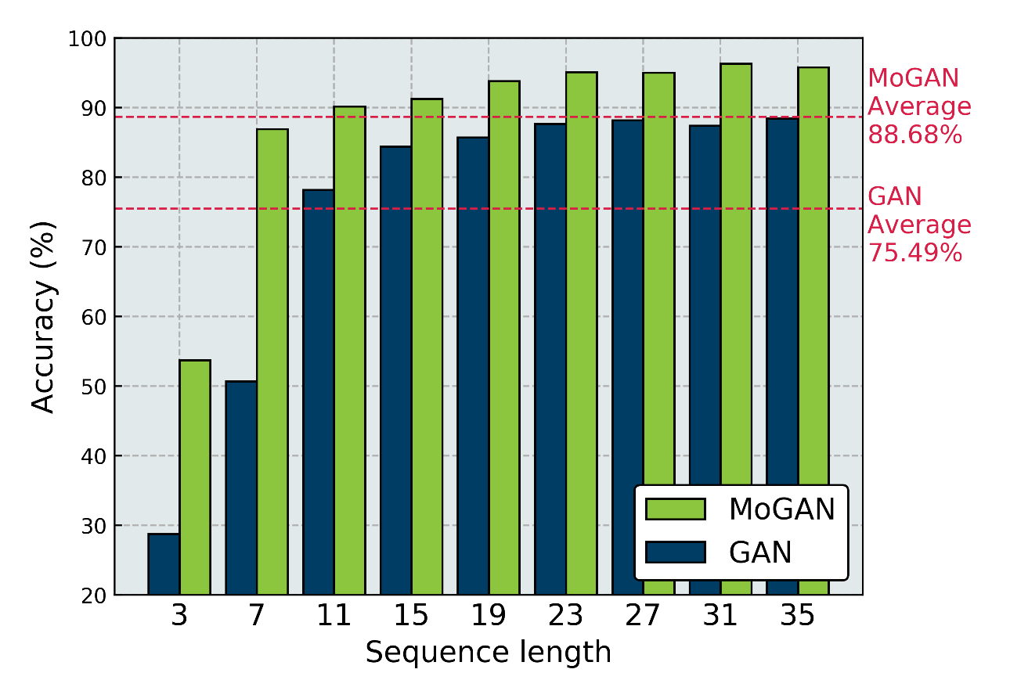
Evaluations
Next PoA prediction accuracy comparison between MoGAN and vanilla GAN for different sequence lengths
17/21

Slide 18
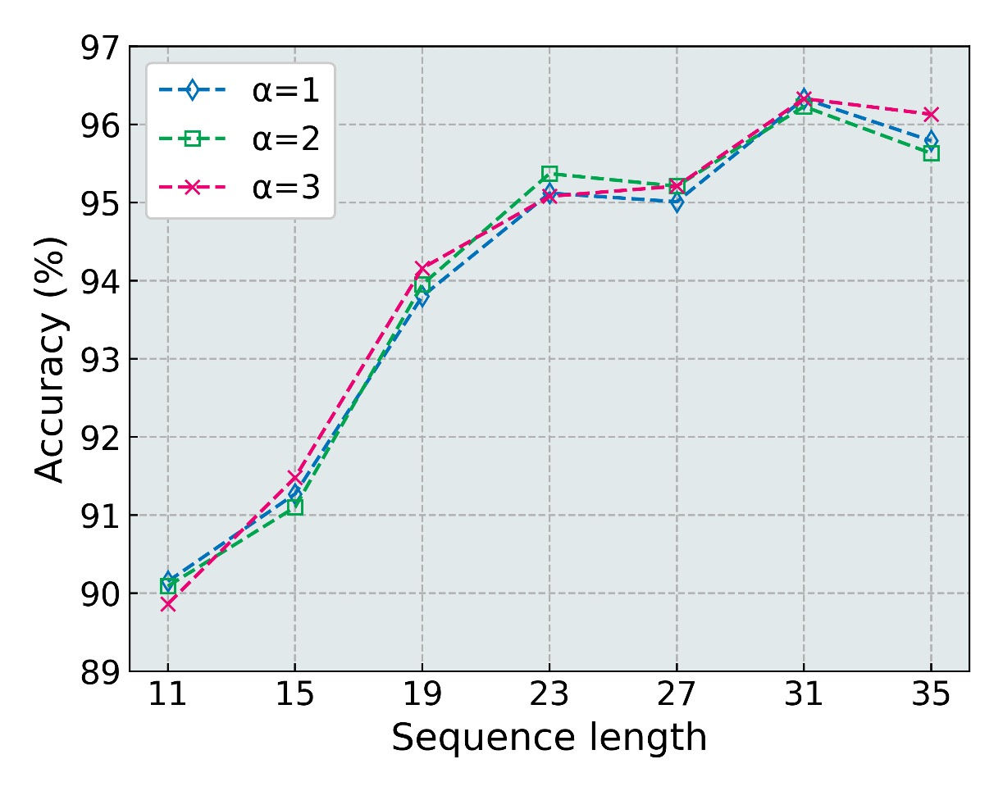
Evaluations
Analysis of MoGAN with different iterations of Step 2 training (𝛼) with increasing sequence length
18/21

Slide 19
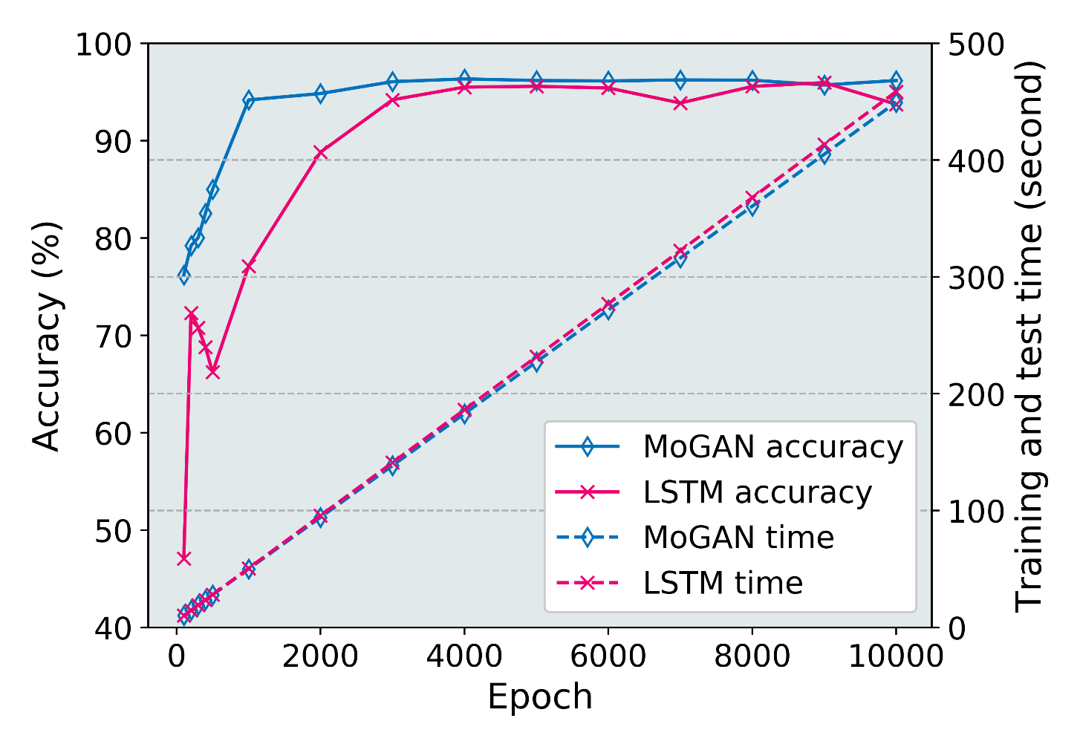
Evaluations
Performance comparison between MoGAN and stacked LSTM in terms of next PoA prediction accuracy and time cost
19/21

Slide 20
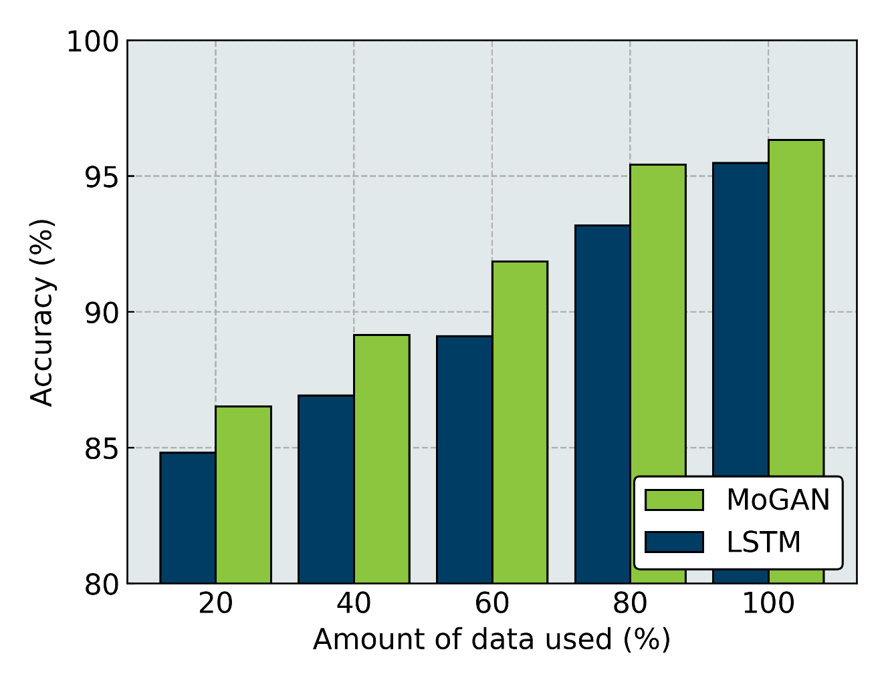
Evaluations
MoGAN and LSTM performance comparison with limited data
20/21

Slide 21
Conclusions
MoGAN achieved maximum 96.33% accuracy
For perspective this means that if 3,000 users perform handover at a given time, MoGAN correctly predicts next PoA for 2,890 users
Predicting next PoA for a user takes 5.85ms, which makes MoGAN suitable to be used in real mobile network
Improved method for data-based prediction is suggested which can be used in other domains
Future work
Improvement of MoGAN through other attention mechanisms
Extend MoGAN from single step to multiple step prediction
21/21

Slide 22
Thank You!

